Slide 1

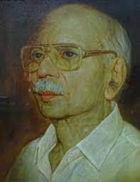
VISVODAYA ENGINEERING COLLEGE :: KAVALI (Affiliated to JNTUA, Anantapuram & Approved by AICTE) Kavali - 524201 SPSR Nellore dist., Andhra Pradesh. VEHICLE SAFETY SYSTEM USING IOT SENSORS
VISVODAYA ENGINEERING COLLEGE :: KAVALI (Affiliated to JNTUA, Anantapuram & Approved by AICTE) Kavali- 524201 SPSR Nellore dist., Andhra Pradesh. Abstract review Design and analysis of IOT based intelligent robot for real-time monitoring and control
Guided by
Mr. SK. Shabbir Basha
(Associate Professor)
presented by:
V.LAKSHMI PRANATHI P.CHANDUPRIYA 204N1A3556 204N1A3531
G.VIJAY M.NIKHITHA 204N1A3512 204N1A3525

Slide 2
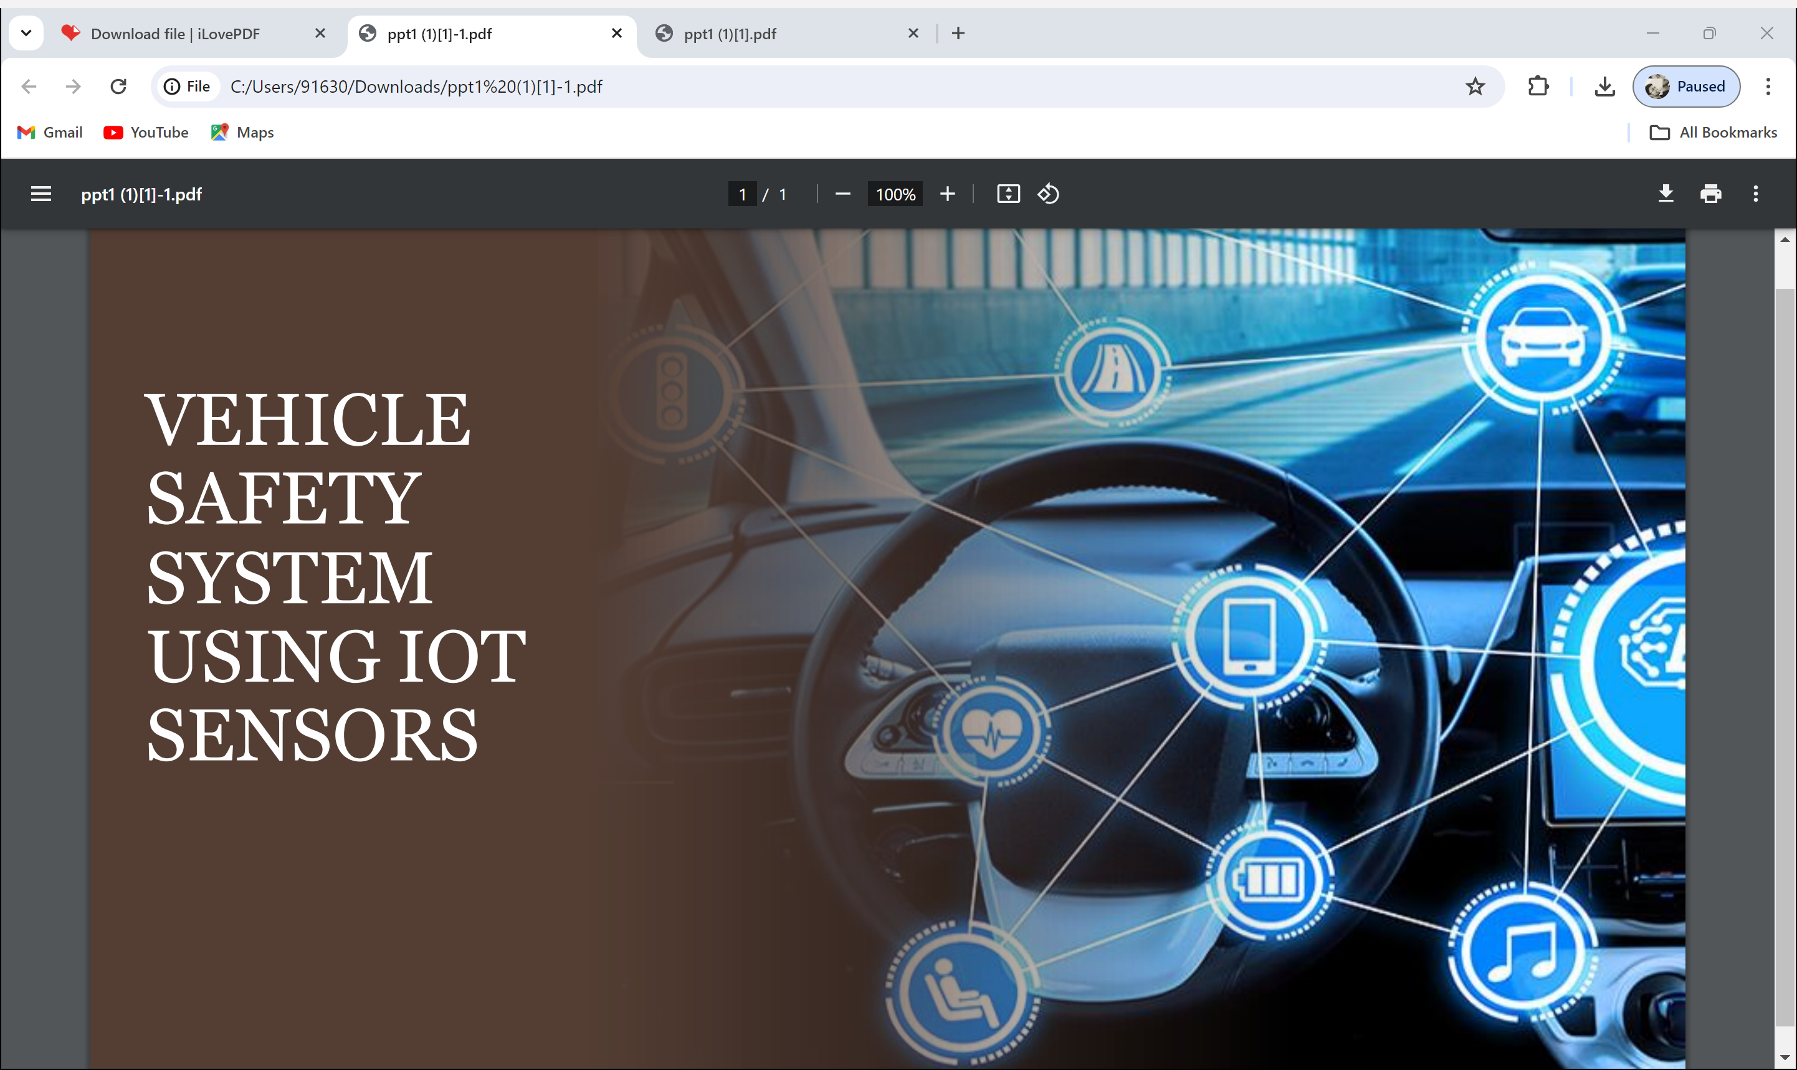

Slide 3
Contents :
Statement
Existing system and Proposed system
Architecture
Connections
Hardware and Software requirements
Advantages And Disadvantages
Conclusion

Slide 4
Statement :
Number of vehicles on our roads is increasing day by day also the technology but the safety factor is always needed to be considered. Now a days vehicles come fitted with lots of safety features. Some of the essential safety feature that need to be installed is automatic Alcohol detection , fire detection and object detection system.
These features are added to reduce the accident cases and to improve safety measures for the customers.

Slide 5
Existing system :
The existing systems described in the mentioned research papers utilize Arduino , the MQ2 gas sensor , fire sensor , PIR sensors to detect alcohol consumption ranges , detect and respond to the presence of a flame and detect obstacles and provide safety to customers from the worst situations. They incorporate features such as GSM , GPS Tracker ,auditory feedback through buzzers. These systems can measure the alcohol ranges near the driver seat and detect obstacles at a range and offer various forms of feedback, including alarm and sending messages to the family and authorities with the location.

Slide 6
:Proposed system :
Alcohol sensor is installed on the steering of the car, with the end goal that when the level of liquor crosses a reasonable farthest point, where the start of vehicle will kill and the motor will stop. The Arduino always uses the alcohol sensor information to check drunk driving and works a bolt on the vehicle motor to stop the engine. Vehicle safety is a critical concern in modern transportation systems, with the increasing need for advanced technologies to enhance driver awareness and mitigate risks on the road

Slide 7
Proposed system :
The automatic Fire detection sensor and PIR sensors are placed to detect and respond to the presence of a flame. And an object-detection system which uses radio waves to determine the range, direction, or speed of objects. It can be used to detect motor vehicles.
Both these sensors detect the harm and sent the messages to the drivers and authorities for alerting them and automatic buzzer is used to attract the near by people to seek the help.

Slide 8
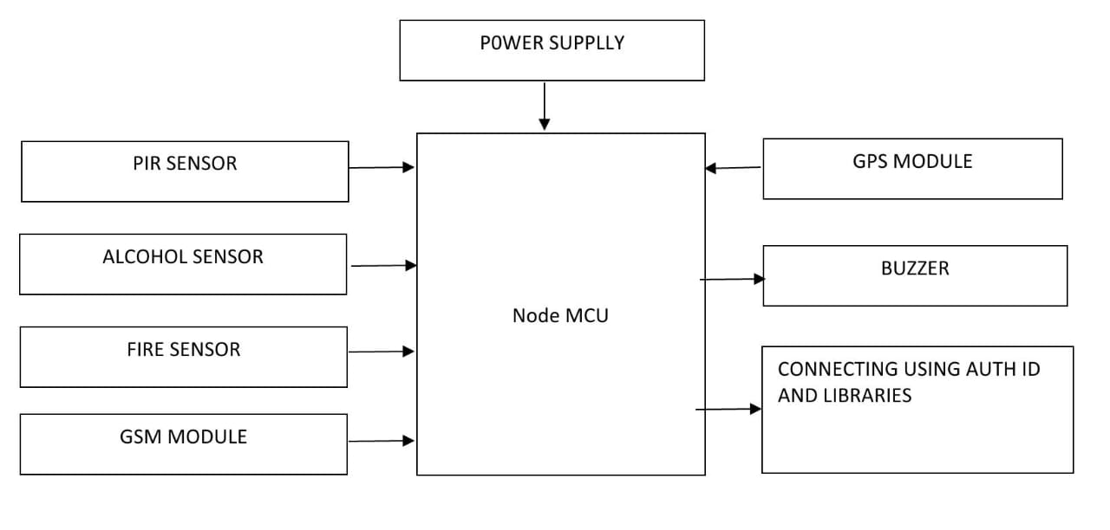
Architecture

Slide 9
Component Connections:
MQ2 Gas Sensor :
IR Sensor :
Fire Sensor :
GSM Module TX :
GSM Module RX :
GPS Module TX :
GPS Module RX :
Motor Control :
LCD Display SDA :
LCD Display SCL :
Buzzer :
Components Power :
AO (Analog)
D1 (Digital)
D2 (Digital)
D3 (Digital)
D4 (Digital)
D5 (Digital)
D6 (Digital)
D7 (Digital)
D2 (Digital)
D1 (Digital)
D8 (Digital)
5V (VCC), GND (Ground)
cONNECTIONS

Slide 10
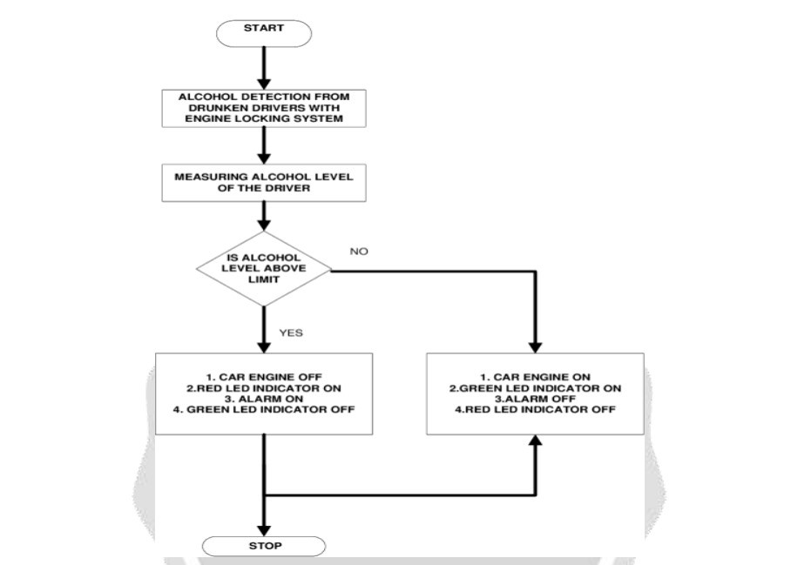
Architecture

Slide 11
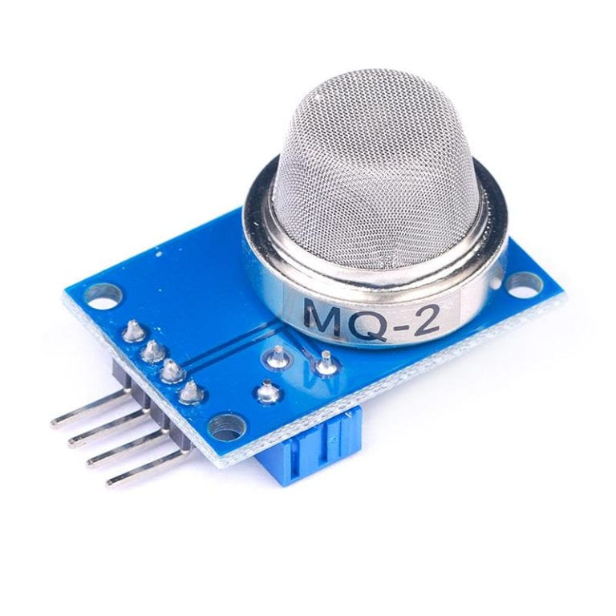
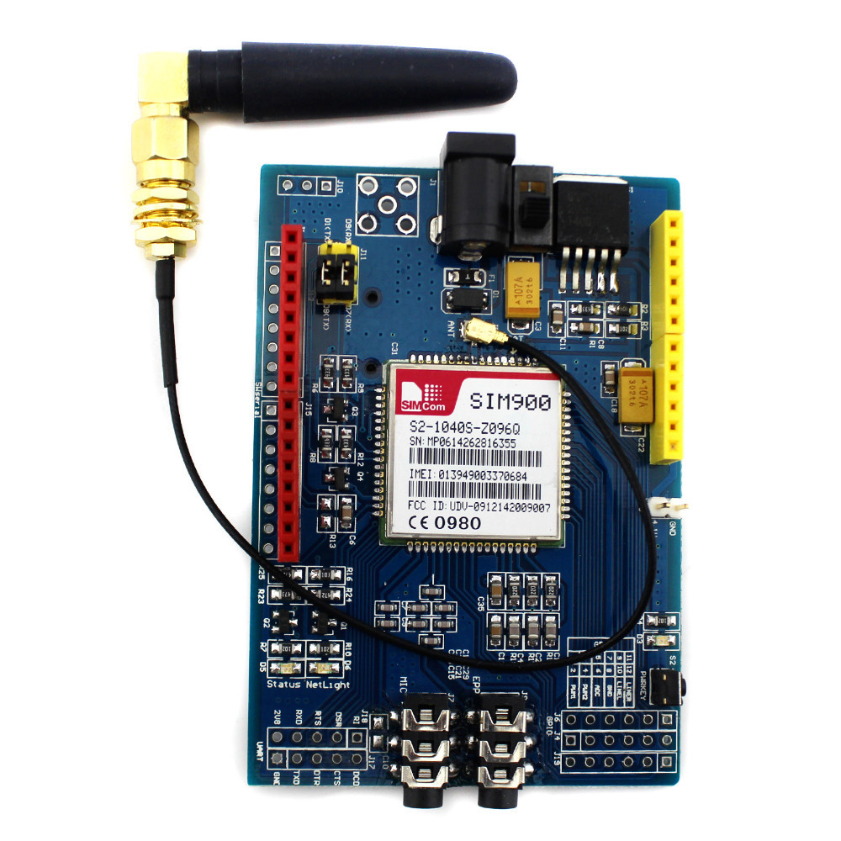
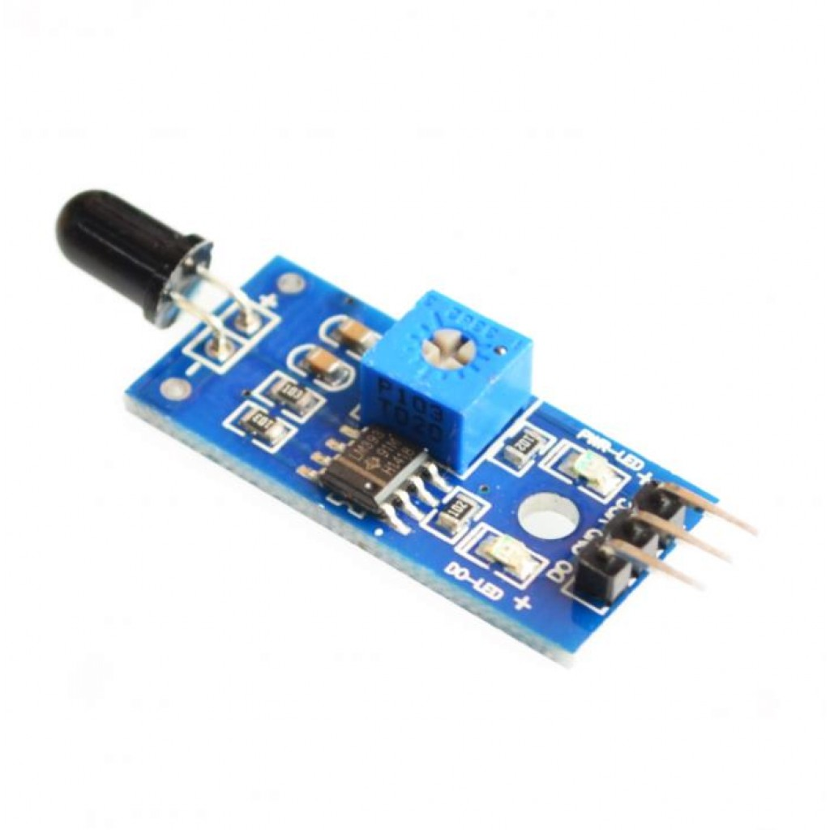
Hardware and Software requirements :
Software :
Hardware :
Arduino IDE
MQ2 gas sensor
PIR sensor
Fire sensor(photoelectric)
Arduino uno board
Motor
GPS module
GSM modem
Sim card
Motor
Buzzer
Lcd panel

Slide 12
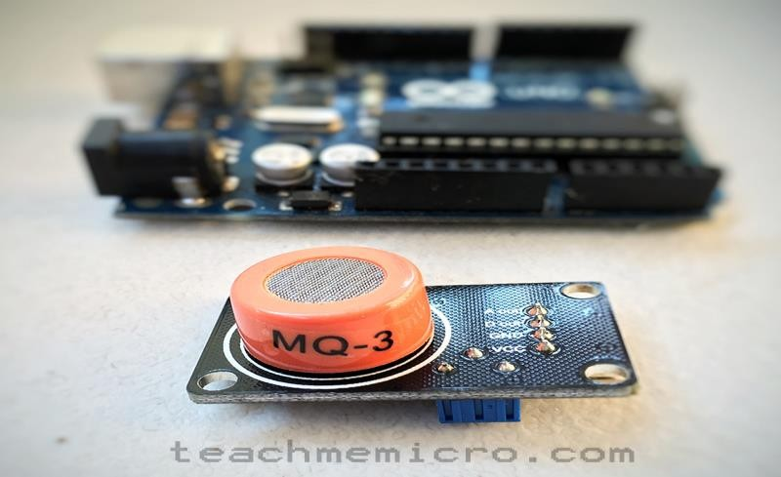
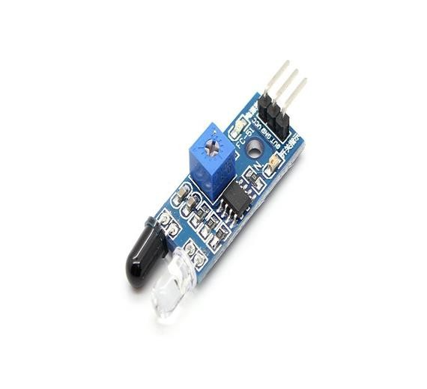

Alcohol Sensor(MQ2):
The analog gas sensor- MQ3 is suitable for alcohol detecting; this sensor can be used in a breath analyzer. It has a high sensitivity to alcohol and small sensitivity to benzene.
IR Sensor :
Motion is detected by means of a PIR sensor, a passive infrared sensor. This sensor detects emitted infrared energy from objects (humans and animals, but also cars) in the form of heat.
Fire Sensor :
A flame-sensor is one kind of detector which is mainly designed for detecting as well as responding to the occurrence of a fire or flame. The flame detection response can depend on its fitting .

Slide 13
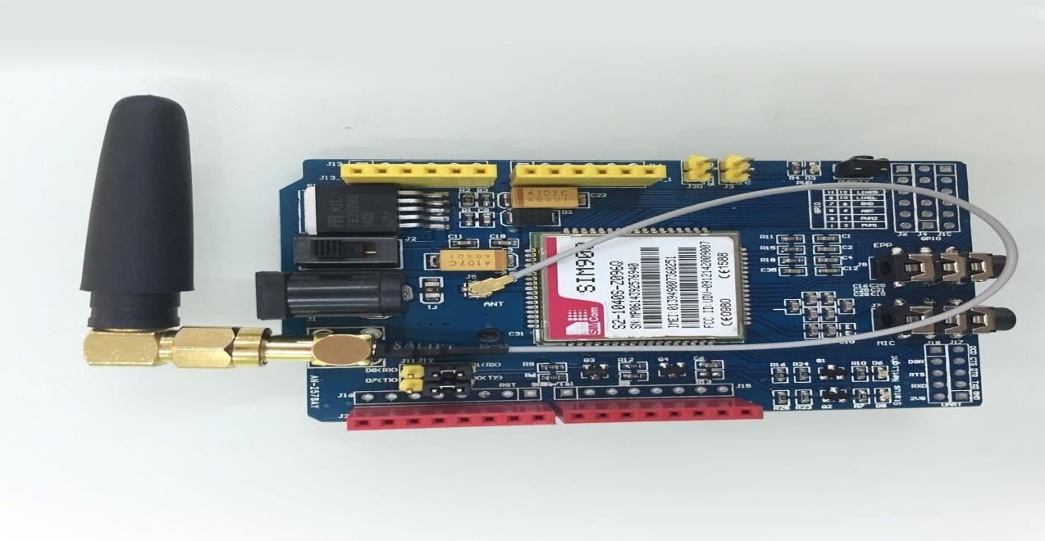
GSM Module :
A GSM Module is a specialized type of modem which accepts a SIM card, and operates over a subscription to a mobile operator, just like a mobile phone.
These GSM modules are most frequently used to provide mobile internet connectivity, many of them can also be used for sending and receiving SMS and MMS messages
GPS Module :
A GPS navigation device is a device that accurately calculates geographical location by receiving information from GPS satellites .

Slide 14
WOR K I NG P R INC IP L E :
The Mq3 Sensor when driver starting car/vehicle then alcohol sensor start Sensing At that condition vehicle speed equal to zero. If alcoholic driver detected then immediate ignition system will turn off along with SMS about detection is send to relevant of driver for notification and notification will be displayed on LCD with alarm.
At the same time SMS with current location of vehicle ,vehicle number and detected information send to relative of driver and police station. With the help of GPS and GSM module

Slide 15
WOR K ING P R INC IP L E
The fire sensor in the car if the pressure in the sensor tube increases due to rise in the temperature of the protected area beyond the threshold values, the system triggers an alarm, which in turn is used to actuate an extinguishing system.
The ir sensor in the working involves a short ultrasonic sound wave being transmitted towards the target. The target reflects back the wave which confirms the presence of the object. These sensors can measure the distance of the object from the sensor.

Slide 16
Disadvantages :
Advantages :
Increased Safety
Cost Reduction
Detects motion reliably in indoors as well as in day or dark
fire detection and Instant suppression capabilities.
Increased Power Consumption
Security Risks
Will Not Work Everywhere

Slide 17
Conclusion :
Vehicle safety system using IoT offers numerous benefits and applications, including improved safety, enhanced convenience, and cost reduction. Real-world examples from Tesla, Ford, and General Motors showcase the potential of IoT technology within the automotive industry.

Slide 18
Thank you

